Slide 1
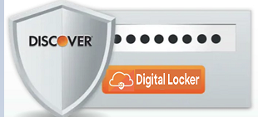
Discover dLocker
Team – “Access Denied”

Slide 2

Why
Digital Identities (DiD) are integral part of the decentralized digital world.
Digital Identities (DiD) are stored in a digital wallets (apps like connect.me app etc). If the cell phone is lost or becomes unusable, the whole wallet is gone.
Holders need to go back to all issuers to get the digital identities re-issued, which is troublesome process.
There is no product that gives the digital backup in the decentralized world
Notes:
Tell us what the goal, value and/or benefit is

Slide 3

What
Our product solution enables customers to store and access the backup of their digital wallet in any unprecedented times.
The backup could include any type of digital keys, ids, credentials, and other types of cryptographic materials.
The customer provides the Auth Digital Id (to authenticate himself) and Locker Digital Id to access their Locker.
The customer can also restore Auth Digital Id and Locker Digital Id in case they lost them.
The Trust Triangle - Issue and verify process happens in decentralized identity framework

Slide 4

Who
Customers who care for digital Identities to be safely backed up.
Customers who uses digital identity wallets.
Customers who want to store any type of digital keys and cryptographic materials.
Customers who like to have business relationship with trusted digital banks.

Slide 5
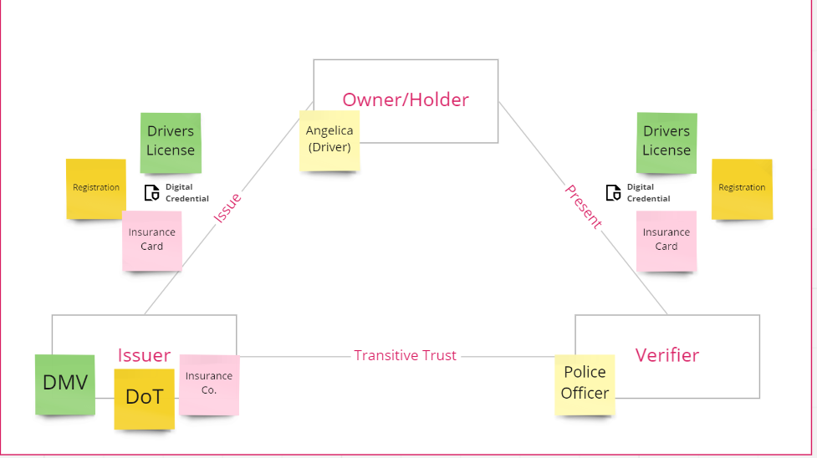
Holder’s typical digital wallet – Trust triangle

Slide 6
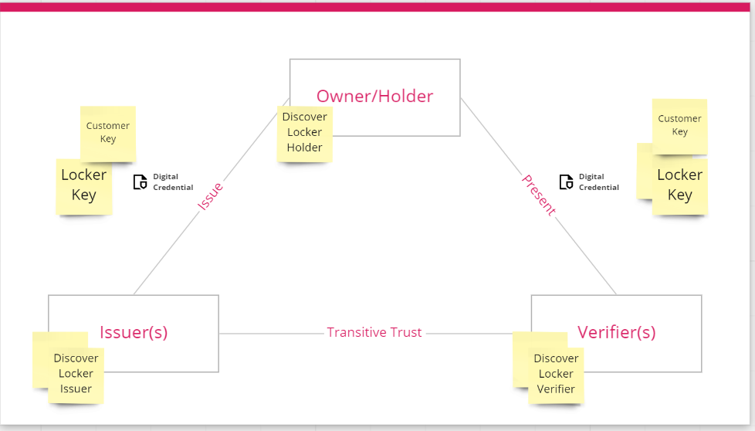
Discover dLocker – Trust triangle

Slide 7
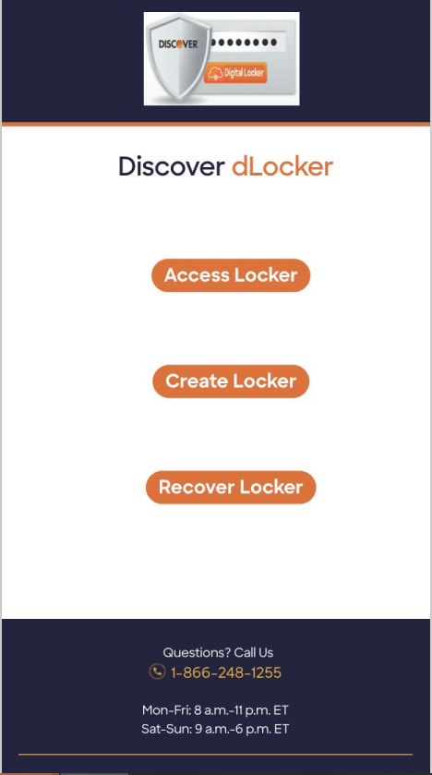
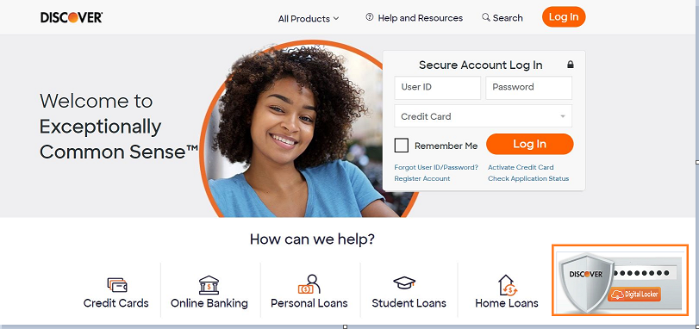
Where
Discover Desktop / Mobile app

Slide 8

When
Customers doesn’t have access to their cell phone
Want to restore their digital wallet in the new cell phone
Add/Update/delete the digital identities from the issuers

Slide 9

Wow
Tell us how this will benefit Discover and the trust triangle stakeholders
Who | Wow Factor
Holder | Backup of all their digital artifacts Secure storage and access of recovery material Easy to use for all customers.
Discover | Wider Customer base including BroadMarket Customers with increase in revenue growth. Complementary with every Discover product sale would increase market awareness and prompt customer towards more digital options. Decouples Digital Recovery using trust triangle approaches providing ease of mind to customer .
More Opportunities for Discover | Complemented by “Passive key compromise” watch/protection service. The provisioned “discover customer” identity can be used by other LOBs to authenticate the user in a decentralized way. Send reminders to customers to do key rotation periodically. Customers can use a separate discover mobile app or existing app with new options to use this feature.

